Slide 1
KM184506 Teknik Simulasi
Lecture 9 : Modeling
Prof. Dr. tech. M. Isa Irawan, MT
02 October 2010

Slide 2
What is modeling?
A Model is a simplification of a real system
Modeling is the process of representing a system with a specific tool to study its behavior
A model can be:
  Analytic: when a mathematical approach is feasible (e.g. Queuing Model)
  Simulation: model used for complex systems
  Experimental: when the real system already exists

Slide 3
Model (Wikipedia)
http://en.wikipedia.org/wiki/Model
A Model is a pattern, plan, representation (especially in miniature), or description designed to show the main object or workings of an object, system, or concept.
Model may also refer to:
  Abstractions, concepts, and theories
  representations of objects
  human and animal behavior
  occupations
  history and culture
  lighting
  In geography …

Slide 4
Examples
In general, modeling is used for systems with some sort of uncertainty
Waiting time in a restaurant/airport
Time to go from home to the University
Response time and Throughput of a web server
The productivity of manufacturing systems
Design of multi-processor machine
Performance of MAC protocols (e.g. CSMA/CA)

Slide 5
Examples: Movement
Consider a system when a given object move
This system can be modeled by the equation
S= V * t
Where S is the distance run through
  V is the speed of the object
  t is the time that has been observed.
This is simplification of the real world
Another model can take into account the direction of movement, or the three dimension coordinate …
It is therefore to study the behaviour of the system based on a specific model
V

Slide 6
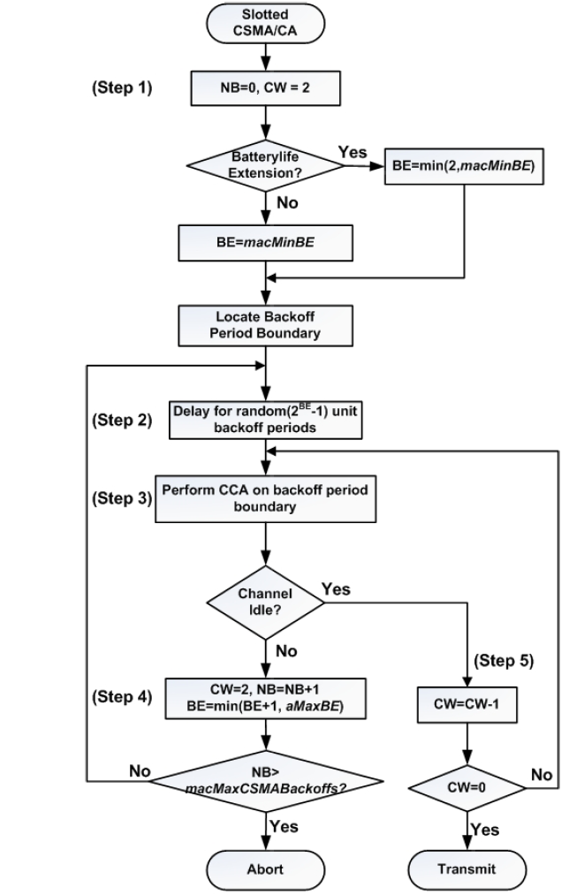
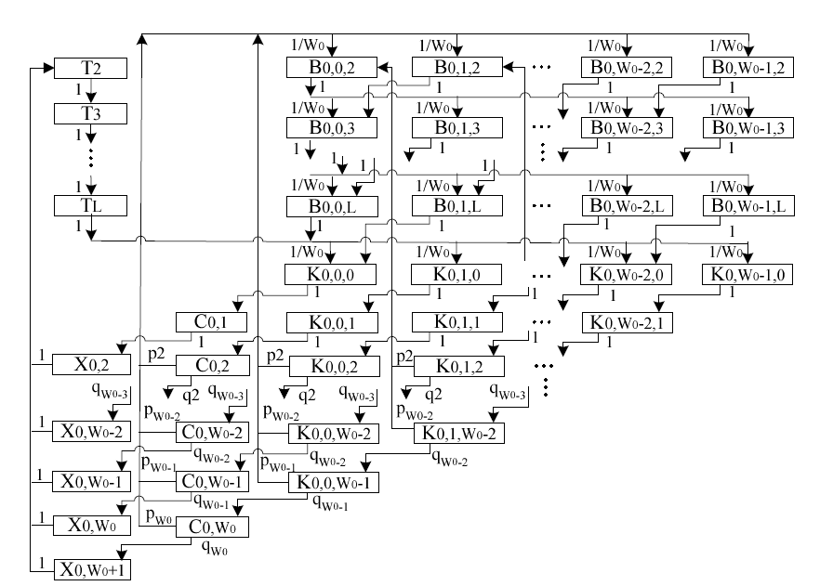
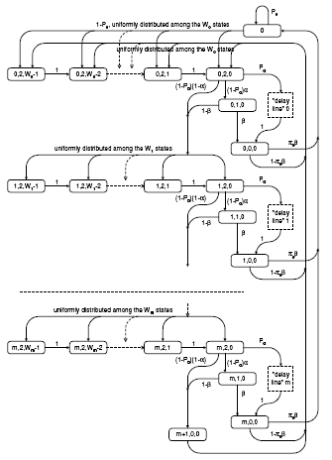
Example: MAC protocols (e.g. CSMA/CA)
Source: HE et al.: AN ACCURATE MARKOV MODEL FOR SLOTTED CSMA/CA ALGORITHM IN IEEE 802.15.4 NETWORKS, IEEE COMMUNICATIONS LETTERS, VOL. 12, NO. 6, JUNE 2008
Jelena Miˇsi´c∗ Vojislav B. Miˇsi´c Shairmina Shafi,
Performance of IEEE 802.15.4 beacon enabled PAN with uplink transmissions in non-saturation mode – access delay for finite buffers, Proceedings of the First International Conference on Broadband Networks (BROADNETS’04)
A. Koubâa, M. Alves, E. Tovar
A Comprehensive Simulation Study of Slotted CSMA/CA for IEEE 802.15.4 Wireless Sensor Networks
In IEEE WFCS 2006, Torino (Italy), June 2006.

Slide 7
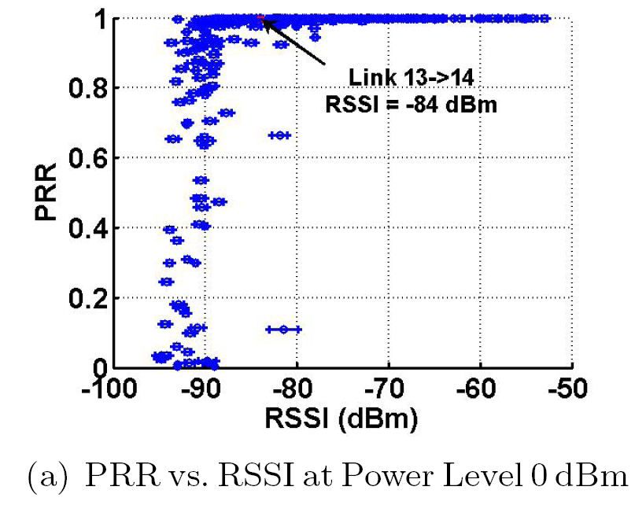

Example: Radio Propagation Models
A radio propagation model is an empirical mathematical formulation for the characterization of radio wave propagation as a function of frequency, distance and other conditions.
Different types of models
  Models for outdoor environments: Ground wave, Sky wave, Environmental Attenuation, Point-to-Point propagation models, Terrain models, City Models
  Models for indoor environments
Free Path Loss Model (Mathematical Model)
Empirical Model of Radio Channel
Source: Kannan Srinivasan and Philip Levis, RSSI is Under Appreciated, ACM Workshop on Embedded Networked Sensors (EmNets 2006),

Slide 8
Characteristics of a model
A model is never equal to the real system
  because it is always simpler than the reality
The accuracy of a model is determined by its tendency to approach the real system
Is that a problem?
  Yes, if the model ignore important parameters of the real system (over simplification)
  No, if the model takes into account the important parameters (ignoring some details is sometimes not problematic)

Slide 9
Performance Evaluation of a System
SYSTEM
Experiment with the
Actual System
Experiment with a
Model of the System
There is always the question of whether it
actually reflects the system.
  Too costly or disruptive
  Not appropriate for the design
Mathematical Model
Make assumptions that take the form of mathematical or logical relationships
Analytical Solution
Simulation
If the model is simple enough. E.g., calculus, algebra, probability theory
Highly complex systems

Slide 10
Simulation Model versus Analytical Model
Simulation is not used when a suitable mathematical model exists
Simulations are often complex error-prone pieces of software
Simulation only produce approximate answers
Simulation can take a LONG time to execute
Mathematical models are less flexible, but they are exact and efficient
The problem is what model represents better the real world?

Slide 11
Classification of Models
Dynamic Models
Represents a system as it evolves over time
Static Models
Time plays no role
Represents the system at a particular point in time
Example: Monté Carlo Method
Example: Cars arriving to a parking

Slide 12
Classification of Models
Deterministic Models
Stochastic Models
No probabilistic component in the system
Example: Worst-Case Analysis of the system
Some components of the system has a probablistic behavior (Random variable, event probability)
Example: Queueing systems

Slide 13
Classification of Models
Continuous Models
Discrete Models
The state of the system changes continuously
The state of the system changes only at discrete points in time.
(e.g., chemical processes)
Bit Arrival in a Queue
# of cars in a parking lot
bit
bit
time
time
Continuous Model
Discrete Model

Slide 14
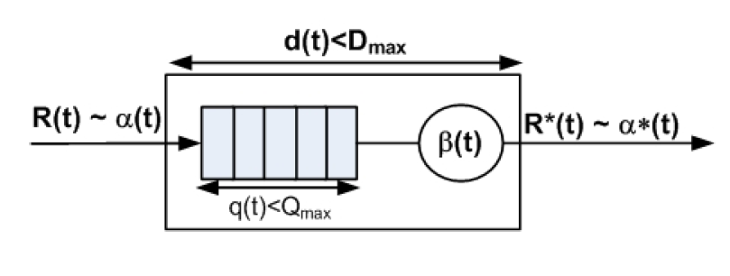
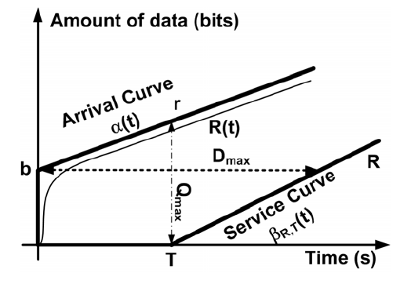
Example: Deterministic vs. Stochastic
Queueuing System
Deterministic Performance
Using Network Calculus
Stochastic Performance
Using Queueing Theory

Slide 15
Model Development Lifecycle
Define goals, objectives of study
Develop conceptual model
Fundamentally an iterative process
Develop specification of model
Develop computational model
Verify model
Validate model

Slide 16
Model Development Lifecycle
Determine Goals and Objectives
What do you want to do with the model?
It may be an end in itself
More often, it is a means to an end
Goals may not be known when you start the project!
One often learns things along the way
Develop Conceptual Model
An abstract representation of the system
What should be included in model? What can be left out?
What abstractions should be used? What is the level of details?
Appropriate choice depends on the purpose of the model

Slide 17
Model Development Lifecycle
Develop Specification Model
A more detailed specification of the model including more specifics
Collect data to populate model
Example:
Traffic: Road geometry, signal timing, expected traffic demand, driver behavior
Communication: network topology, message type, inter-arrival time, data rates
Empirical data or probability distributions often used
Develop a Computational Model
Executable simulation model
Software approach
General purpose programming language
Special purpose simulation language
Other (non-functional) requirements
Performance
Interoperability with other models/tools/data

Slide 18
Model Development Lifecycle
Verification
Did I Build the Model Right? هل أنجزت النموذج بطريقة صحيح؟
Does the computational model match the specification model?
Debugging: checking if the program contains any programming errors.
Verification is different from Validation: (see model validation)!
If you can validate the simulation with 100% certainty, why build the simulation?
Often can only validate portions of the model
By necessity, validation is always an incomplete activity!
Another simulation model
An analytic (mathematical) model of the system
Measurements of actual system
Typically, the validation of a simulation model can be done by comparing
Does the computational model match the actual (or envisioned) system?
Did I Build the Right Model? هل أنجزت النموذج الصحيح؟
Validation

Slide 19
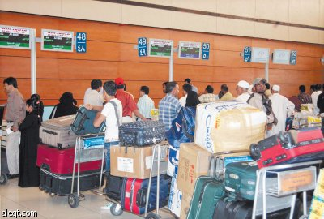
Example: Airport Check-in Desk Queuing
We consider flight check-in desks in an Airport. The administration of the airport wants to improve its quality of service by reducing the waiting time of travelers. For that purpose, they want to design what could be the best queuing strategy to have the minimum waiting time.
The main problem is to know what is the best queuing strategy that reduces the waiting time of travelers in check-in desks.

Slide 20
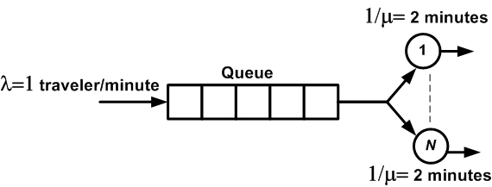
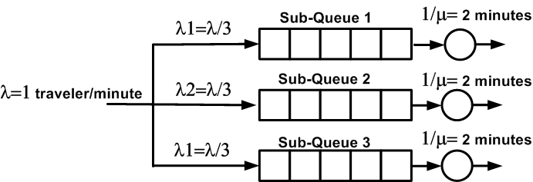
Step. 1. Define the objectives of the study
Main Objective: what is the best queuing strategy that reduces the waiting time of travelers in check-in desks.
Find a model that enables to compute waiting time of travelers
  Solution 1. Queueing Theory (Analytical Model)
  Solution 2. Simulation (Computer Program Model)
Two Possible Models
Model 1
Model 2

Slide 21
Step. 2. Develop Conceptual Model
What are the elements of the system?
Model 1
Model 2
One Queue
N=3 servers
Three Queues
N=3 servers
Customers: travelers that arrive to the check-in desk
Servers: represents the agent (officer) that makes the flight registration

Slide 22
Step. 3. Develop Specification Model
What are the characteristics of the elements of the system?
Model 1
Model 2
One Queue:
  Length= 60 Travelers
N=3 Agents
  Service rate: 30 travelers/hour
Travelers arrive with a rate
1 travelers/minute
Three Queue:
  Length= 20 Travelers/Queue
N=3 Agents
  Service rate: 30 travelers/hour
Travelers arrive with a rate 1 travelers/minute
Travelers choose a queue with a probability of 1/3.

Slide 23
Step. 4. Develop Computation Model
Analytical Model: Queueing Theory
Model 1
Model 2
Model 1 is better than Model 2 because it has lower delay

Slide 24
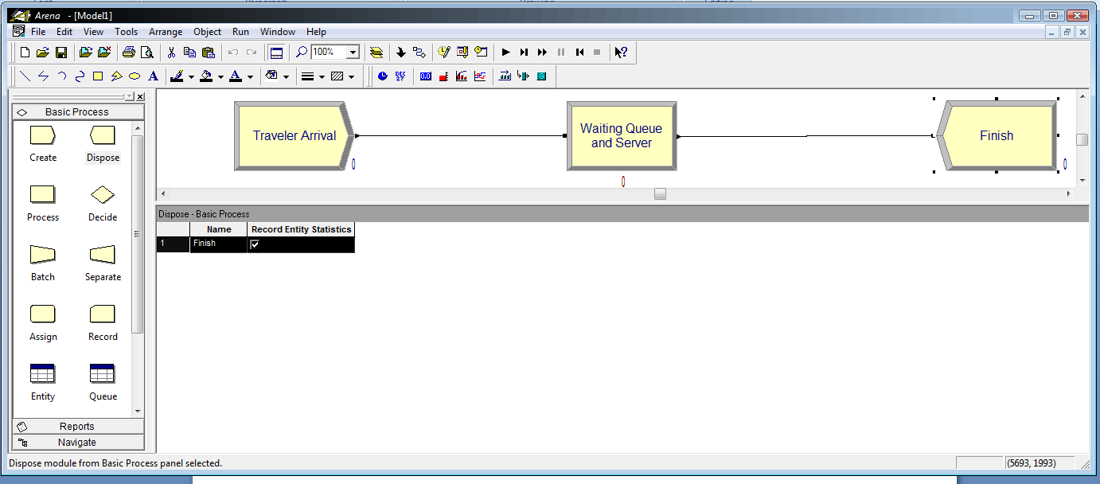
Step. 4. Develop Computation Model
Simulation Model: Arena
Model 1
Model 2
Model 1 is better than Model 2 because it has lower delay

Slide 25
Step. 4. Develop Computation Model
Simulation Model: Arena
6 Best Free Bioinformatics Software For Windows (listoffreeware.com)
6 Best Free Bioinformatics Software For Windows (listoffreeware.com)

Slide 26


Al-Imam Mohammad Ibn Saud University
Special Thanks to
Dr. Anis Koubâa
Al-Imam Mohammad bin Saud University

